Slide 1
Colombia in the world 11TH GRADE
“La interdisciplinariedad es algo excelente si se sustenta firmemente en la disciplinariedad. Cada asignatura se debe considerar una herramienta eficaz, no un fin en sí misma. Debemos mantener su identidad y, sobre todo, su propia metodología. Solo de esta manera podremos construir una verdadera interdisciplinariedad. De lo contrario, solo lograremos confundir a nuestros alumnos y abordar las materias superficialmente.”
Gérard Renaud, 1989
Andrés Verano – Foreign Language
Daniel Vargas – Social Studies

Slide 2
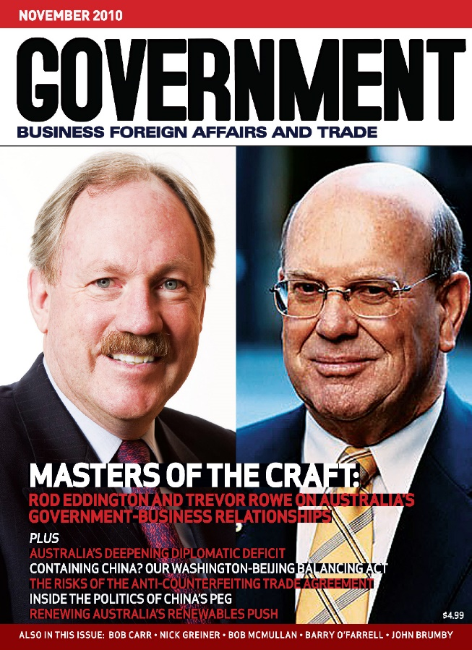
Colombia in the world
“La comprensión interdisciplinaria es la capacidad de integrar conocimientos y formas de pensar de dos o más disciplinas para crear una nueva perspectiva [...] una nueva comprensión [...] no sustituye a la enseñanza disciplinaria, sino que la amplía.”
Verónica Boix Mansilla, miembro del equipo Harvard Project Zero

Slide 3
Descripción del proyecto
Áreas implicadas
Duración del proyecto
Estimación de costos
English & Social Studies
One term.
Students will not have special expenses product of this porject.

Slide 4
Contenidos y Desempeños
ASIGNATURA | CONTENIDOS | DESEMPEÑOS
Asignatura 1: English | Reading plan: MyOn platform reading texts over 900 Lexile. Reading comprehension in topics that are mildly academic. Vocabulary on success, government, policies, culture, history, infrastructure, leaders, etc. Writing of formal texts. | Students read and write formally about mildly academic topics, using the proper vocabulary for the context of an online magazine.
Asignatura 2: Social Studies | Colombia’s government system Overview of Colombia in terms of geography, , government, policies, culture, history, infrastructure, leaders, etc. | Students understand the particularities of Colombia as a country, nation, territory, and state, as compared to countries all over the world by using an online magazine.

Slide 5
Entregables
PRODUCTO ESPERADO: Students will create an online magazine that covers different aspects of their country such as culture, history, geography, government, leaders, infrastructure, etc.
Entregas |  | English | Social Studies
I BIM | 1 | Evidence of having read a book in the MyOn platform that has a Lexile over 900 and covers the topic of government of a country different from Colombia. Due date: The third week in the first term. | Evidence of having read a book in the MyOn platform that has a Lexile over 900 and covers the topic of government of a country different from Colombia. Due date: The third week in the first term.
 | 2 | Students make a colorful infographics comparing the country selected with Colombia in the same terms of the book read on the platform. Due date: The sixth week of the first term. | Students make a colorful infographics comparing the country selected with Colombia in the same terms of the book read on the platform. Due date: The sixth week of the first term.
 | 3 | Students will create an online magazine that covers different aspects of their country such as culture, history, geography, government, leaders, infrastructure, etc. Due date: 9th week of the 1st term. | Students will create an online magazine that covers different aspects of their country such as culture, history, geography, government, leaders, infrastructure, etc. Due date: 9th week of the 1st term.

Slide 6
Estimación de costos por grupo de trabajo
Describir lo que el estudiante debe hacer y entregar y presupueste los costos aproximados de lo que los materiales o insumos necesarios para el desarrollo del proyecto. (Ajuste la tabla de acuerdo con la duración del proyecto)
 | Entrega | Material o insumo | Costo aproximado por grupo de estudiantes
I BIM | 1 | None (Done on the MyOn platform) | None
 | 2 | Infographics (The cost depends on the type of means decided to create the infographics. Simple cardboard and colors are recommended) | $5.000 COP
 | 3 | None (Magazine will be done in an online platform) | None

